Slide 1
Artificial Intelligence
VPI, HMM, Particle filters
Notes:
Slides and exercises are inspired by Russell & Norvig AI Book, Stanford’s AI course and from Berkeley’s AI course

Slide 2
Decision networks
Bayes nets + nodes for utility and actions
Action node
Action selection
Instantiate all evidence
Calculate posterior of all parents of utility nodes given the evidence
Calculate expected utility for each action
Choose maximizing action
Umbrella
U
Forecast
Chance node
Utility node
Weather

Slide 3
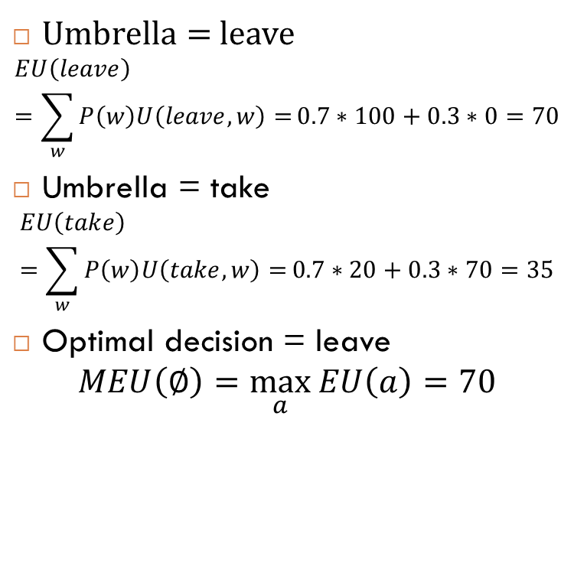
Example
Umbrella = leave
$$EU\left(leave\right)=\sum_{w}{P\left(w\right)U\left(leave,w\right)=}0.7∗100+0.3∗0=70$$
Umbrella = take
$$EU\left(take\right)=\sum_{w}{P\left(w\right)U\left(take,w\right)=}0.7∗20+0.3∗70=35$$
Optimal decision = leave
$$MEU\left(∅\right)=\max_{a}{EU\left(a\right)=70}$$
Umbrella
U
Weather
W | P(W)
Sun | 0.7
Rain | 0.3
A | W | U(A,W)
Leave | Sun | 100
Leave | Rain | 0
Take | Sun | 20
take | Rain | 70

Slide 4
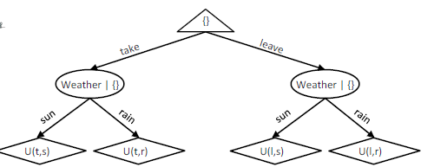
Tree representation of a decision network

Slide 5
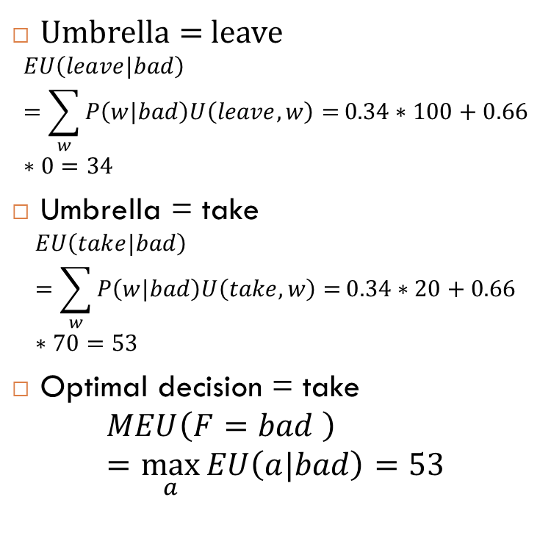
Example
Umbrella = leave
$$EU\left(leave|bad\right)=\sum_{w}{P\left(w|bad\right)U\left(leave,w\right)=}0.34∗100+0.66∗0=34$$
Umbrella = take
$$EU\left(take|bad\right)=\sum_{w}{P\left(w|bad\right)U\left(take,w\right)=}0.34∗20+0.66∗70=53$$
Optimal decision = take
$$MEU\left(F=bad \right)=\max_{a}{EU\left(a|bad\right)=53}$$
Umbrella
U
Weather
W | P(W|F=bad)
Sun | 0.34
Rain | 0.66
Forecast =bad
A | W | U(A,W)
Leave | Sun | 100
Leave | Rain | 0
Take | Sun | 20
take | Rain | 70

Slide 6
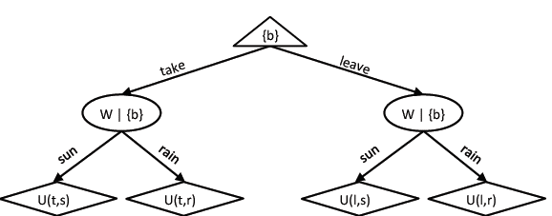
Outcome tree

Slide 7
Value of information
Idea: compute value of acquiring evidence
Example: buying oil drilling rights
Two blocks A and B, exactly one has oil, worth k
You can drill in one location
Prior probabilities 0.5 each, and mutually exclusive
Drilling in either A or B has EU = k/2
MEU = k/2
Question: what’s the value of information of the variable O (Oil location)?
Value is expected gain in MEU from new info
If we know OilLoc, MEU is k (either if it happens to be A or B)
VPI (OilLoc) = k – k/2 = k/2
Fair price of this information = k/2
DrillLoc
U
OilLoc
O | P(O)
A | 0.5
B | 0.5
D | O | U(D,O)
A | A | k
A | B | 0
B | A | 0
B | B | k

Slide 8
Example
You’re playing the lottery. The prize will be $0 or $100.
You can play any number between 1 and 100 (chance of winning is 1%).
What is The value of knowing the winning number?
Notes:
99

Slide 9
Value of perfect information
Assume we have evidence E=e
Assume we see another variable E’=e’
E’ is a random variable that we ignore, what is the added value if we know perfect information about E’
Value of information: how much MEU goes up by revealing E’ first than acting, over acting now

Slide 10
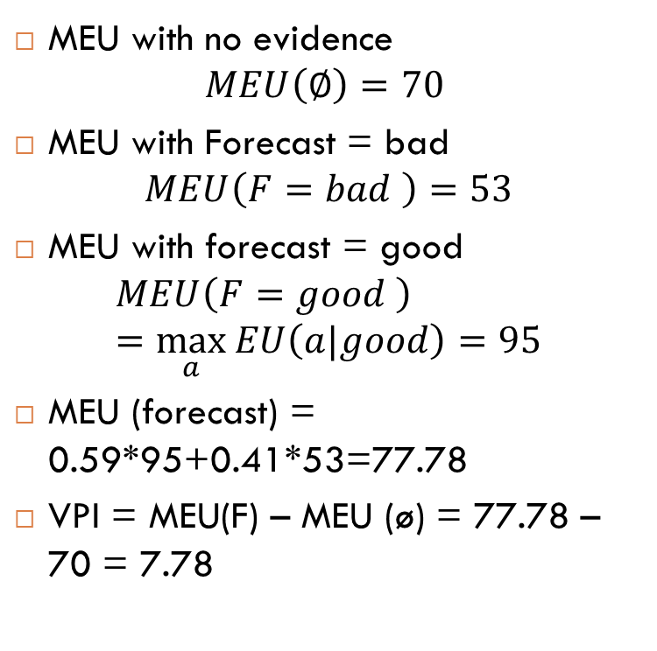
Example
MEU with no evidence
$$MEU\left(∅\right)=70$$
MEU with Forecast = bad
$$MEU\left(F=bad \right)=53$$
MEU with forecast = good
$$MEU\left(F=good \right)=\max_{a}{EU\left(a|good\right)}=95$$
MEU (forecast) = 0.59*95+0.41*53=77.78
VPI = MEU(F) – MEU (ø) = 77.78 – 70 = 7.78
Umbrella
U
Weather
W | P(W)
Sun | 0.7
Rain | 0.3
Forecast
A | W | U(A,W)
Leave | Sun | 100
Leave | Rain | 0
Take | Sun | 20
take | Rain | 70
F | P(F)
Good | 0.59
Bad | 0.41

Slide 11
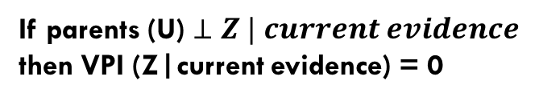
VPI properties
Non- negative
Non additive (think about observing E’ twice)
Order independent
DrillLoc
U
OilLoc
Scout
If parents (U) $⊥Z | current evidence$
then VPI (Z|current evidence) = 0
Scouting report
Notes:
Example VPI (Scout) = 0 because OilLoc is conditionally independent of Scout given no information about Scouting report

Slide 12
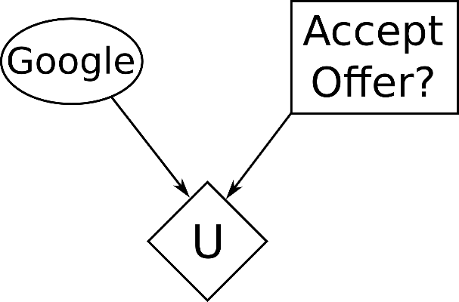
Exercise
You've been job hunting, and you've narrowed your options to two companies: Acme and Google. You already have an offer from Acme, but it expires today, and you are still waiting for a response from Google. You are faced with the dilemma of whether or not to accept the offer from Acme, which is modeled by the following decision diagram:
Your prior belief about whether Google will hire you and utility over possible outcomes are as follows:
Google outcome | P(Google outcome)
hired | 0.25
not hired | 0.75

Slide 13
Ex – cnt
What is the expected utility of each action?
Which action should you take?
Action | Google outcome | U
accept Acme offer | hired | 2000
accept Acme offer | not hired | 8000
reject Acme offer | hired | 10000
reject Acme offer | not hired | 0
Google outcome | P(Google outcome)
hired | 0.25
not hired | 0.75
Notes:
Accept / reject : 6500 / 2500
Accept

Slide 14
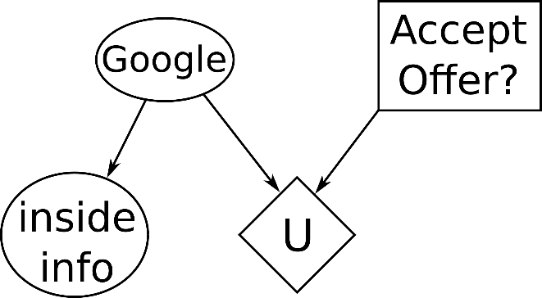
Ex – cnt.
Suddenly, the phone rings. It's your uncle, who works at Google. Your uncle tells you he has some inside information about the status of your application. Your uncle won't tell you what the information is yet, but he might be willing to divulge it for the right price. You model the new situation by adding a new node to your decision diagram:
You create a CPT to model the relationship between the inside information and Google's future hiring decision
info | Google outcome | P(info | Google outcome)
good news | hired | 0.7
bad news | hired | 0.3
good news | not hired | 0.1
bad news | not hired | 0.9

Slide 15
Ex – cnt.
What are the expected utilities for each action, for each possible type of information we could be given?
EU(accept Acme offer, good news)=?
EU(reject Acme offer, good news)=?
EU(accept Acme offer, bad news)=?
EU(reject Acme offer, bad news)=?
Google outcome | P(Google outcome)
hired | 0.25
not hired | 0.75
Action | Google outcome | U
accept Acme offer | hired | 2000
accept Acme offer | not hired | 8000
reject Acme offer | hired | 10000
reject Acme offer | not hired | 0
info | Google outcome | P(info | Google outcome)
good news | hired | 0.7
bad news | hired | 0.3
good news | not hired | 0.1
bad news | not hired | 0.9
Notes:
EU(Good, accept) = 3800 = P(hired|good) * U(hired, accept) + P(not hired| good) * U(not hired, accept) = 0.7*2000+0.3*8000
EU(Good, reject ) = 7000
EU(Bad, accept) = 7400
EU(Bad reject ) =1000

Slide 16
Ex – cnt.
What is the maximum expected utility for each type of information we could be given?
MEU ( good news) = ?
MEU (bad news) =?
If we are given the inside information, what is the expected value of MEU?
What is the value of perfect information of the random variable Inside Info?
Notes:
7000
7400
7300
800

Slide 17
Properties of VPI
VPI is guaranteed to be nonnegative (≥0).
The MEU after observing a node could potentially be less than the MEU before observing that node.
VPI is guaranteed to be exactly zero for any node that is conditionally independent (given the evidence so far) of all parents of the utility node.

Slide 18
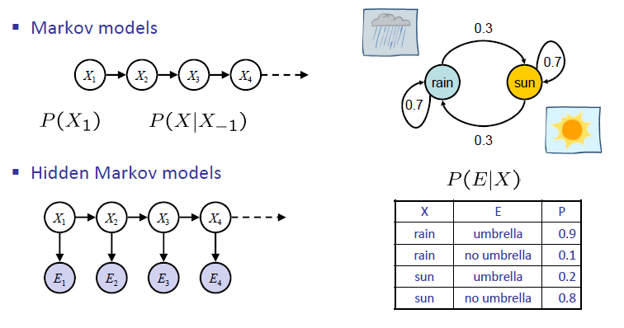
Hidden Markov Models
Transition model
Emission model

Slide 19
Markov Models
A Markov model is a chain‐structured BN
Each node is identically distributed (stationarity)
Value of X at a given time is called the state
As a Bayes’ net:
Parameters: called transition probabilities or dynamics, specify how the state evolves over time (also, initial state probabilities)
Same as MDP transition model, but no choice of action
X₁
X₂
X₃
X₄
P(X₁)
P(X_{t}|X_{t-1})

Slide 20
Markov Models
Past and future are independent given the present
Each time step only depends on the previous
This is called the (first order) Markov property
the chain is just a (growable) BN, so we can always use generic BN reasoning on it if we truncate the chain at a fixed length
X₁
X₂
X₃
X₄
P(X₁)
P(X_{t}|X_{t-1})

Slide 21
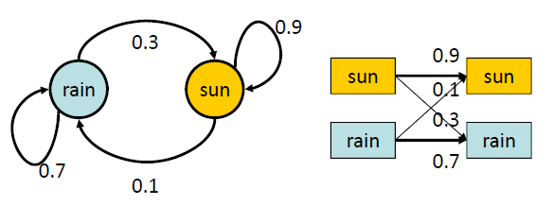
Example: Sunny / Rainy
States = {Rain , Sun}
CPT:
Day 1: Sun
X_{t-1} | X_{t} | P(Xt-1|X_{t})
Sun | Sun | 0.9
Sun | Rain | 0.1
Rain | Sun | 0.3
Rain | Rain | 0.7
Viterbi or trellis diagram
Automaton or finite state machine diagram

Slide 22
Mini-forward algorithm
Question: What’s P(X_{t}) on some day t?
An instance of variable elimination! (In order X₁, X₂, … )
Forward simulation:
X₁
X₂
X₃
X₄
P(X₁)
P(X_{t}|X_{t-1})

Slide 23
Example run of the mini forward algorithm
From initial observation of sun:
From initial observation of rain:
From yet another initial distribution P(X₁):
1.0 | 0.9 | 0.84 | 0.804 | … | 0.75
0 | 0.1 | 0.16 | 0.196 | … | 0.25
P(X₁) | P(X₂) | P(X₃) | P(X₄) | … | P(X∞)
0 | 0.3 | 0.48 | 0.588 | … | 0.75
1.0 | 0.7 | 0.52 | 0.412 | … | 0.25
P(X₁) | P(X₂) | P(X₃) | P(X₄) | … | P(X∞)
P | .. | .. | .. | … | 0.75
1-p | .. | .. | .. | … | 0.25
P(X₁) | P(X₂) | P(X₃) | P(X₄) | … | P(X∞)

Slide 24
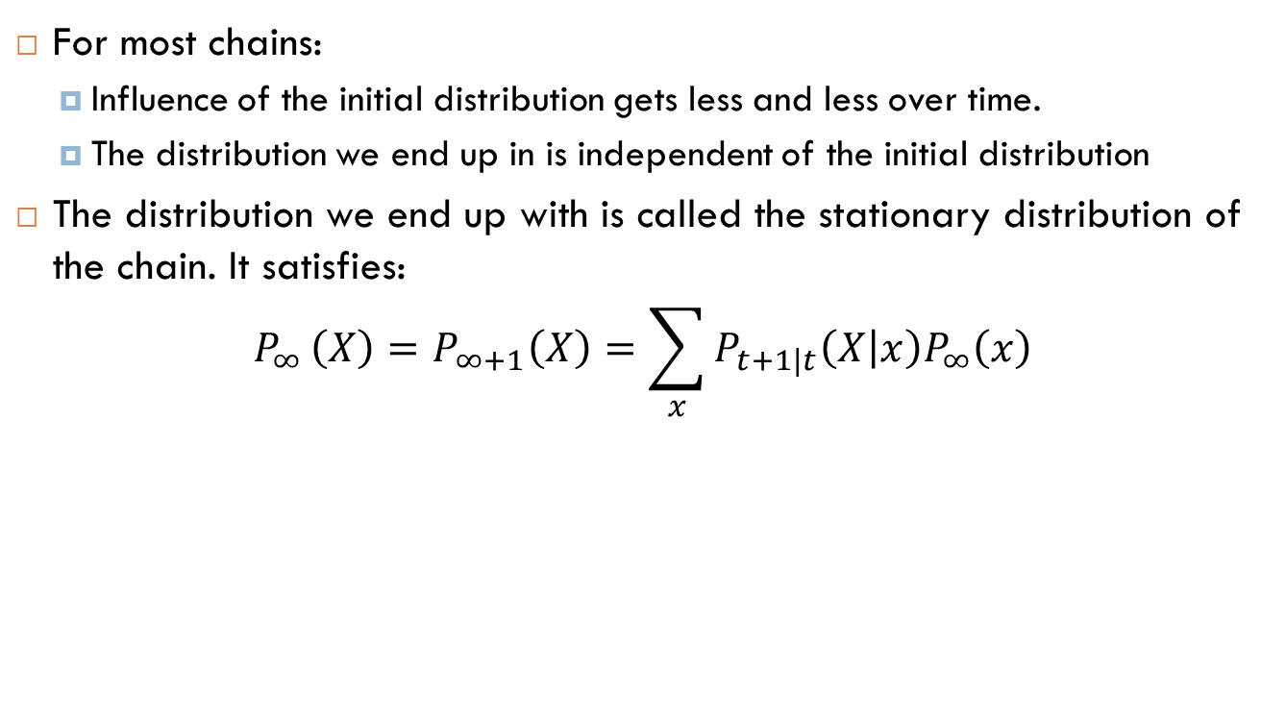
Stationary distributions
For most chains:
Influence of the initial distribution gets less and less over time.
The distribution we end up in is independent of the initial distribution
The distribution we end up with is called the stationary distribution of the chain. It satisfies:
$$P_{∞ }\left(X\right)=P_{∞+1}\left(X\right)=\sum_{x}{P_{t+1|t}\left(X | x\right)P_{∞}\left(x\right)}$$

Slide 25
Hidden Markov models
Need to introduce time in our models
Need observations to update your beliefs
HMMs are defined by:
States X
Observations E
Initial distribution P(X₁)
Transition model P( X_{t}| X_{t-1} )
Emission model P(E_{t}|X_{t})
X₁
X₂
X₃
X₄
E₁
E₂
E₃
E₄
Two important independence properties:
Markov hidden process: future depends on past via the present
Current observation independent of all else given current state
Notes:
Quiz: does this mean that evidence variables are guaranteed to be independent?
[No, they tend to correlated by the hidden state]

Slide 26
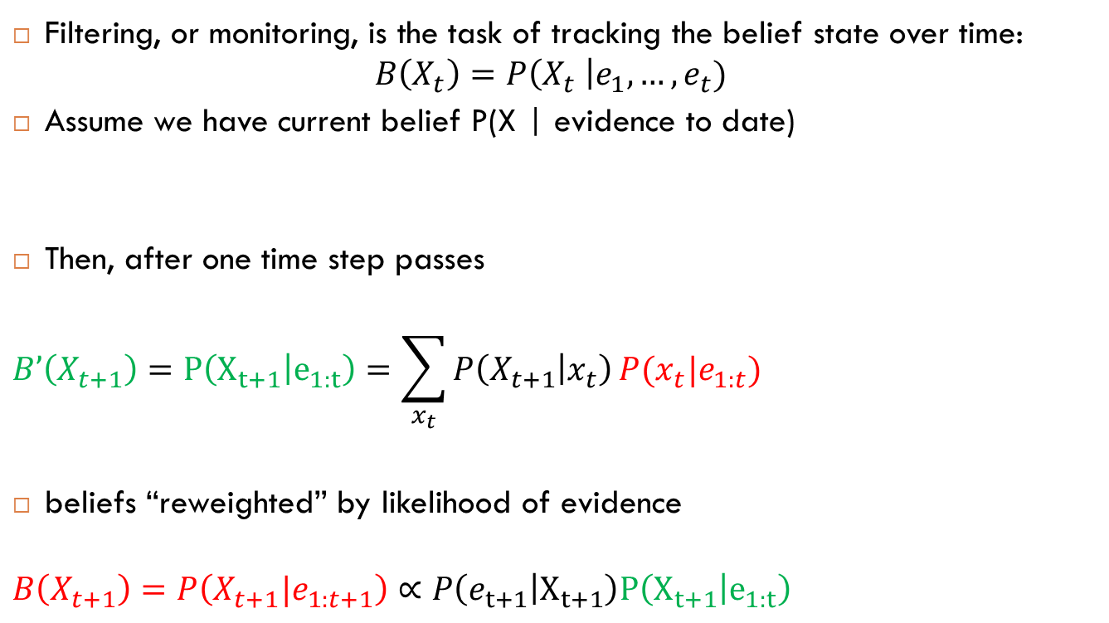
Filtering / monitoring
Filtering, or monitoring, is the task of tracking the belief state over time:
$$B\left(X_{t}\right)=P\left(X_{t} \right|e_{1}, …, e_{t})$$
Assume we have current belief P(X | evidence to date)
Then, after one time step passes
$$B’\left(X_{t+1}\right)=P\left(X_{t+1} | e_{1:t}\right)=\sum_{x_{t}}{P\left(X_{t+1} | x_{t}\right)}P(x_{t}|e_{1:t})$$
beliefs “reweighted” by likelihood of evidence
$$B\left(X_{t+1}\right)=P\left(X_{t+1}|e_{1:t+1}\right)∝P\left(e_{t+1} | X_{t+1}\right)P\left(X_{t+1} | e_{1:t}\right)$$
Notes:
Filtering asks for the distribution of some hidden variable conditioned on only the evidence up until that point. This is useful when you're doing real-time object tracking, and you can't see the future.
Smoothing asks for the distribution of some hidden variable conditioned on all the evidence, including the future. This is useful when you have collected all the data and want to retroactively go and figure out what was

Slide 27
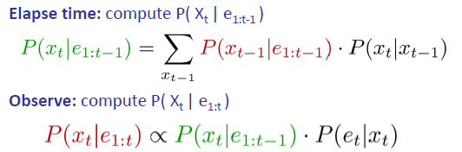
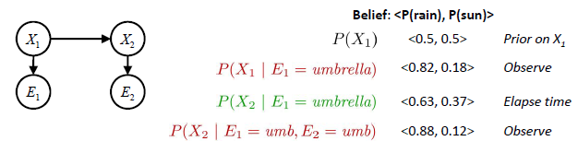
The forward algorithm – example

Slide 28

The forward algorithm
We are given evidence at each time and want to know $B_{t}(X)$
We can derive the following updates
This is exactly variable elimination with order X₁ , X₂, …
Problem: space is |X| and time is |X|² per time step
We can normalize as we go if we want to have P(x|e) at each time step, or just once at the end…
Notes:
The forward algorithm does both update for time and update for evidence at once (and doesn’t normalize)

Slide 29
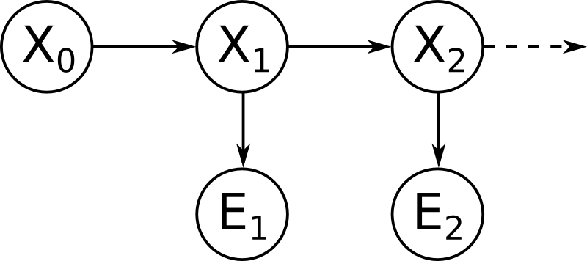
Exercise
Consider the HMM shown below.
The prior probability P(X0), dynamics model P(Xt+1|Xt), and sensor model P(Et|Xt) are as follows:
Perform a first dynamics update, and give the resulting belief distribution B′(X1).
Incorporate the evidence E1=c. Give the evidence-weighted distribution P(E1=c|X1)B′(X1), and the (normalized) belief distribution B(X1).
Perform the second dynamics update, incorporate the evidence E2=c and give B(X2).
X0 P(X0)
0 0.4
1 0.6
Et Xt P(Et|Xt)
a 0 0.1
b 0 0.25
c 0 0.65
a 1 0.2
b 1 0.65
c 1 0.15
Xt+1 Xt P(Xt+1|Xt)
0 0 0.15
1 0 0.85
0 1 0.3
1 1 0.7

Slide 30
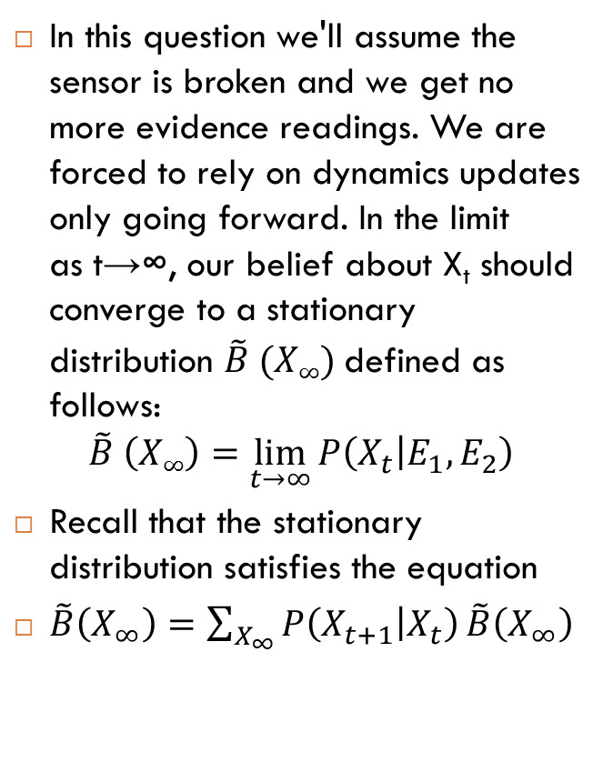
Exercise
In this question we'll assume the sensor is broken and we get no more evidence readings. We are forced to rely on dynamics updates only going forward. In the limit as t→∞, our belief about X_{t} should converge to a stationary distribution $\tilde{B} (X∞)$defined as follows:
$$\tilde{B} \left(X∞\right)=\lim_{t→∞}{P\left(X_{t} | E_{1},E_{2}\right)}$$
Recall that the stationary distribution satisfies the equation
$\tilde{B}\left(X_{∞}\right)=\sum_{X_{∞}}{P\left(X_{t+1} | X_{t}\right)}\tilde{B}\left(X_{∞}\right)$
Et Xt P(Et|Xt)
a 0 0.7
b 0 0.1
c 0 0.2
a 1 0.1
b 1 0.25
c 1 0.65
X0 P(X0)
0 0.85
1 0.15
Xt+1 Xt P(Xt+1|Xt)
0 0 0.5
1 0 0.5
0 1 0.95
1 1 0.05

Slide 31
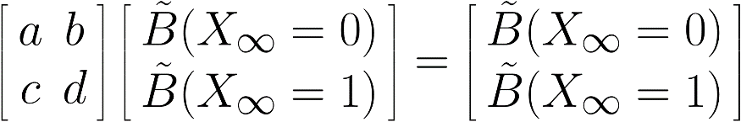
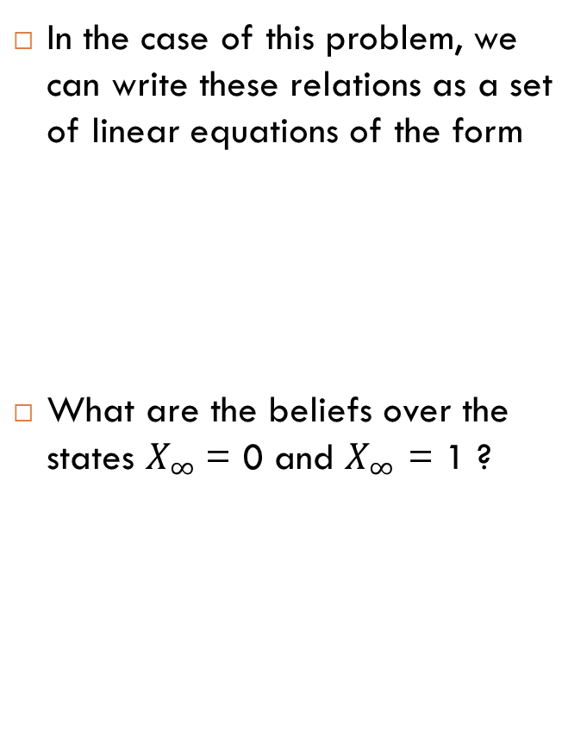
Exercise – cnt
In the case of this problem, we can write these relations as a set of linear equations of the form
What are the beliefs over the states $X_{∞}$= 0 and $X_{∞}$ = 1 ?
Et Xt P(Et|Xt)
a 0 0.7
b 0 0.1
c 0 0.2
a 1 0.1
b 1 0.25
c 1 0.65
X0 P(X0)
0 0.85
1 0.15
Xt+1 Xt P(Xt+1|Xt)
0 0 0.5
1 0 0.5
0 1 0.95
1 1 0.05
Notes:
0.6551
0.3449

Slide 32
Application of HMM: Robot Localization
Example from Michael Pfeiffer
Prob
0
1
t=0
Sensor model: never more than 1 mistake
Motion model: may not execute action with small prob.

Slide 33
Example: Robot Localization
Prob
0
1
t=1

Slide 34
Example: Robot Localization
Prob
0
1
t=2

Slide 35
Example: Robot Localization
Prob
0
1
t=3

Slide 36
Example: Robot Localization
Prob
0
1
t=4

Slide 37
Example: Robot Localization
Prob
0
1
t=5

Slide 38
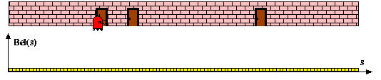
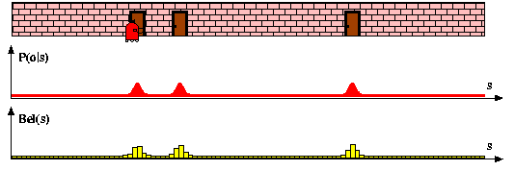
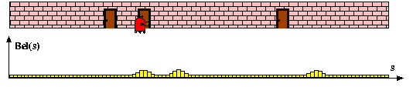
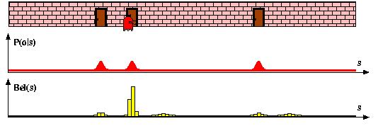
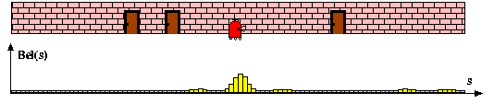
Example: HMMs in Robotics

Slide 39
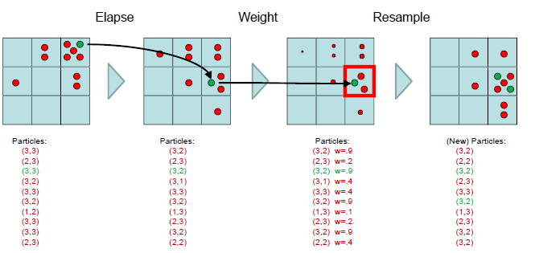
Particle filtering

Slide 40
Particle filters simulation

Slide 41
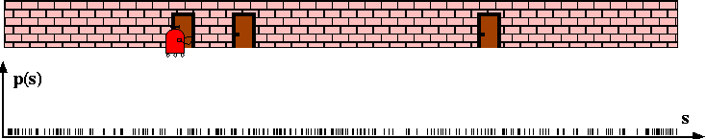
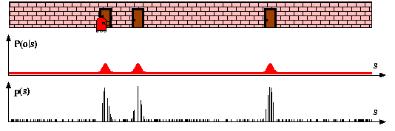
Particle filter – Importance sampling (weighting )

Slide 42
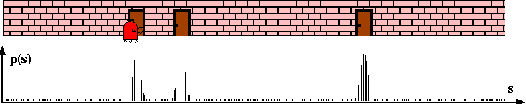
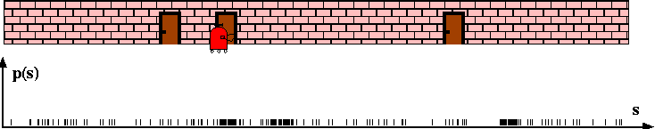
Particle filter – resampling + elapsing time

Slide 43
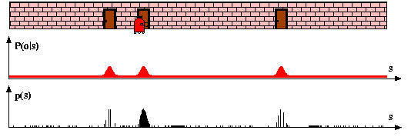
Re-weigthing after new observation

Slide 44
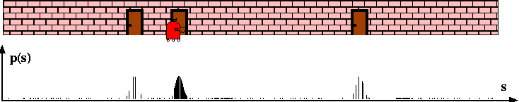
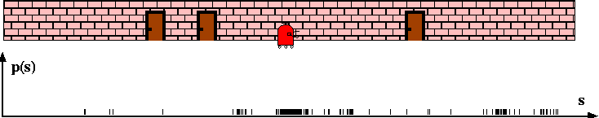
Resampling + elapsing time

Slide 45
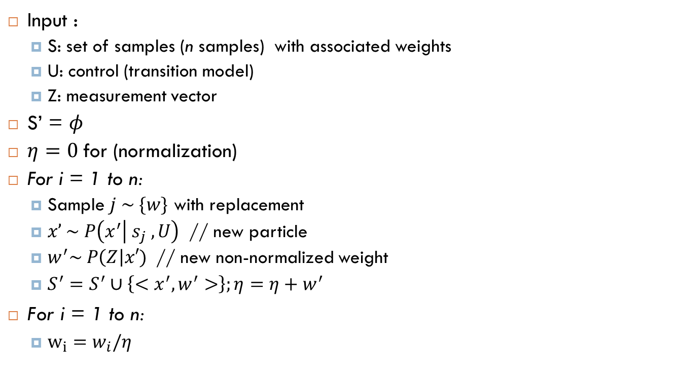
Implementation
Input :
S: set of samples (n samples) with associated weights
U: control (transition model)
Z: measurement vector
$\text{S}\text{’ = }φ$
$η=0$for (normalization)
For i = 1 to n:
Sample $j \sim \{w\}$ with replacement
$x’ \sim P\left(x^{′} | s_{j} , U\right)$ // new particle
$w^{′}\sim P\left(Z\right|x′)$ // new non-normalized weight
$S^{′}=S^{′}∪\left\{<x^{′}, w^{′}>\right\};η=η+w^{′}$
$\text{For} \text{i}\text{ = 1 }\text{to} \text{n}\text{:}$
$w_{i}=w_{i}/η$

Slide 46
Particle filters pros and cons
(+) Easy to implement
(+) Works well in many applications
(-) Don’t work in high dimensional spaces (number of particles is exponential to the number of dimensions)
(-) Problems with degenerate conditions ( think about having only one or two particles)
Remix things, add some noise

Slide 47
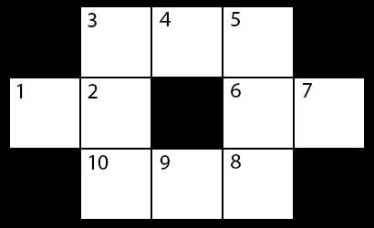
Exercise
Use a particle filter to track the state of a robot that is lost in this map
The robot's state is represented by an integer 1≤Xt≤10 corresponding to its location in the map at time t. We will approximate our belief over this state with N=8 particles.

Slide 48
Transition model
You have no control over the robot's actions. At each time step, the robot either stays in place, or moves to any one of its neighboring locations, all with equal probability. For example, if the robot starts in state Xt=7, it will move to state Xt+1=6 with probability 1/2 or Xt+1=7 with probability 1/2. Similarly, if the robot starts in state Xt=2, the next state Xt+1 can be any element of {1,2,3,10}, and each occurs with probability 1/4.

Slide 49
Sensing
At each time step, a sensor on the robot gives a reading Et∈{H,C,T,D} corresponding to the type of state the robot is in. The possible types are:
Hallway (H) for states bordered by two parallel walls (4,9).
Corner (C) for states bordered by two orthogonal walls (3,5,8,10).
Tee (T) for states bordered by one wall (2,6).
Dead End (D) for states bordered by three walls (1,7).

Slide 50
Sensor errors
The sensor is not very reliable: it reports the correct type with probability 1/2, but gives erroneous readings the rest of the time, with probability 1/6 for each of the three other possible readings.

Slide 51
Sensor model
Sensor Reading | State Type | P(Sensor | State Type)
H | H
C | H
T | H
D | H
H | C
C | C
T | C
D | C
Sensor Reading | State Type | P(Sensor | State Type)
H | T
C | T
T | T
D | T
H | D
C | D
T | D
D | D

Slide 52
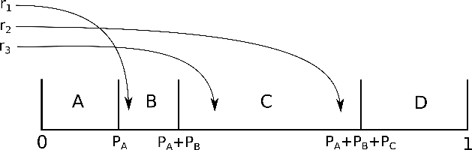
Sampling review
Suppose that we want to sample from a set of 4 events, {A,B,C,D}, which occur with corresponding probabilities P_{A},P_{B},P_{C},P_{D}.
First, we form the set of cumulative weights, given by {0, P_{A}, P_{A}+P_{B}, P_{A}+P_{B}+P_{C}, 1}.
These weights partition the [0,1) interval into bins.
We then draw a number r uniformly at random from [0,1) and pick A, B, C, or D based on which bin r lands in.

Slide 53
Belief State for t=0
Now we will sample the starting positions for our particles. For each particle p_{i}, we have generated a random number r_{i} sampled uniformly from [0,1).
Use these numbers to sample a starting location for each particle. As a reminder, locations are integers from the range [1,10], as shown in the map. You should assume that the locations go in ascending order and that each location has equal probability.
Particle | p1 | p2 | p3 | p4 | p5 | p6 | p7 | p8
r_{i} | 0.914 | 0.473 | 0.679 | 0.879 | 0.212 | 0.024 | 0.458 | 0.154
Locationx₀

Slide 54
Time update from t=0→t=1
Now we'll perform a time update using the transition model.
Possible locations are sorted in ascending numerical order
Particle | p1 | p2 | p3 | p4 | p5 | p6 | p7 | p8
Location: x₀ | 10 | 5 | 7 | 9 | 3 | 1 | 5 | 2
Particle | p1 | p2 | p3 | p4 | p5 | p6 | p7 | p8
r_{i} | 0.674 | 0.119 | 0.748 | 0.802 | 0.357 | 0.736 | 0.425 | 0.058
Location: x₁
Notes:
You should again sample from the range [0,1), where the bins are the possible locations sorted in ascending numerical order . As an example, if Xt=2, the next state can be one of {1,2,3,10}, each with equal probability, so the [0,0.25) bin would be for Xt+1=1, the [0.25,0.5) bin would be for Xt+1=2, the [0.5,0.75) bin would be for Xt+1=3, and the [0.75,1) bin would be for Xt+1=10.

Slide 55
Probability Distribution Induced by the Particles
Recall that a particle filter just keeps track of a list of particles, but at any given time, we can compute a probability distribution from these particles. Using the current newly updated set of particles, give the estimated probability that the robot is in each location.
Particle | p1 | p2 | p3 | p4 | p5 | p6 | p7 | p8
Location: x₁ | 10 | 4 | 7 | 10 | 3 | 2 | 5 | 1
x1 | 1 | 2 | 3 | 4 | 5
P(x1)
x1 | 6 | 7 | 8 | 9 | 10
P(x1)

Slide 56

Incorporating evidence at t=1
Sensor Reading | State Type | P(Sensor | State Type)
H | H | ½
C | H | 1/6
T | H | 1/6
D | H | 1/6
H | C | 1/6
C | C | ½
T | C | 1/6
D | C | 1/6
The sensor reading at t=1 is E₁=D
Using the sensor model, incorporate the evidence by reweighting the particles.
Particle | p1 | p2 | p3 | p4 | p5 | p6 | p7 | p8
Location: x₁ | 10 | 4 | 7 | 10 | 3 | 2 | 5 | 1
Sensor Reading | State Type | P(Sensor | State Type)
H | T | 1/6
C | T | 1/6
T | T | ½
D | T | 1/6
H | D | 1/6
C | D | 1/6
T | D | 1/6
D | D | 1/2
Hallway (H) for states bordered by two parallel walls (4,9).
Corner (C) for states bordered by two orthogonal walls (3,5,8,10).
Tee (T) for states bordered by one wall (2,6).
Dead End (D) for states bordered by three walls (1,7).
Particle | p1 | p2 | p3 | p4
Weight
Normalized Weight
Cumulative Weight
Particle | p5 | p6 | p7 | p8
Weight
Normalized Weight
Cumulative Weight
Notes:
The cumulative weight keeps track of a running sum of all the weights of the particles seen so far (meaning, particle i will have a cumulative weight equal to the sum of the weights of all particles j such that j≤i).

Slide 57
Incorporating evidence at t=1
Sensor Reading | State Type | P(Sensor | State Type)
H | H | ½
C | H | 1/6
T | H | 1/6
D | H | 1/6
H | C | 1/6
C | C | ½
T | C | 1/6
D | C | 1/6
The sensor reading at t=1 is E₁=D
Using the sensor model, incorporate the evidence by reweighting the particles.
Particle | p1 | p2 | p3 | p4 | p5 | p6 | p7 | p8
Location: x₁ | 10 | 4 | 7 | 10 | 3 | 2 | 5 | 1
Sensor Reading | State Type | P(Sensor | State Type)
H | T | 1/6
C | T | 1/6
T | T | ½
D | T | 1/6
H | D | 1/6
C | D | 1/6
T | D | 1/6
D | D | 1/2
Hallway (H) for states bordered by two parallel walls (4,9).
Corner (C) for states bordered by two orthogonal walls (3,5,8,10).
Tee (T) for states bordered by one wall (2,6).
Dead End (D) for states bordered by three walls (1,7).
Particle | p1 | p2 | p3 | p4
Weight | 1/6 | 1/6 | 1/2 | 1/6
Normalized Weight | 1/12 | 1/12 | ¼ | 1/12
Cumulative Weight | 1/12 | 2/12 | 5/12 | 6/12
Particle | p5 | p6 | p7 | p8
Weight | 1/6 | 1/6 | 1/6 | 1/2
Normalized Weight | 1/12 | 1/12 | 1/12 | ¼
Cumulative Weight | 7/12 | 8/12 | 9/12 | 12/12
Notes:
The cumulative weight keeps track of a running sum of all the weights of the particles seen so far (meaning, particle i at will have a cumulative weight equal to the sum of the weights of all particles j such that j≤i).

Slide 58
Re-sampling
Finally, we'll resample the particles. This reallocates resources to the most relevant parts of the state space in the next time update step.
Particle | p1 | p2 | p3 | p4
Cumulative Weight | 0.0833 | 0.167 | 0.4167 | 0.5
Particle | p5 | p6 | p7 | p8
Cumulative Weight | 0.583 | 0.667 | 0.75 | 1
Particle | p1 | p2 | p3 | p4 | p5 | p6 | p7 | P8
Location | 10 | 4 | 7 | 10 | 3 | 2 | 5 | 1
r_{i} | 0.403 | 0.218 | 0.217 | 0.826 | 0.717 | 0.460 | 0.794 | 0.016
New Particle
New Location
Notes:
Notice that your cumulative weights effectively tell you where the bins used in resampling the particles lie. For example, for particle 1, you calculated the cumulative weight to be some value, p. Then, on a random value draw, if a value between 0 and p was chosen, you would generate a new particle where particle 1 is.

Slide 59
Re-sampling
Finally, we'll resample the particles. This reallocates resources to the most relevant parts of the state space in the next time update step.
Particle | p1 | p2 | p3 | p4
Cumulative Weight | 0.0833 | 0.167 | 0.4167 | 0.5
Particle | p5 | p6 | p7 | p8
Cumulative Weight | 0.583 | 0.667 | 0.75 | 1
Particle | p1 | p2 | p3 | p4 | p5 | p6 | p7 | P8
Location | 10 | 4 | 7 | 10 | 3 | 2 | 5 | 1
r_{i} | 0.403 | 0.218 | 0.217 | 0.826 | 0.717 | 0.460 | 0.794 | 0.016
New Particle | p3 | p3 | p3 | p8 | p7 | p4 | p8 | p1
New Location | 7 | 7 | 7 | 1 | 5 | 10 | 1 | 10
Notes:
Notice that your cumulative weights effectively tell you where the bins used in resampling the particles lie. For example, for particle 1, you calculated the cumulative weight to be some value, p. Then, on a random value draw, if a value between 0 and p was chosen, you would generate a new particle where particle 1 is.

Slide 60
Analysis
The sensor provided a reading E₁=D. What fraction of the particles are now on a dead end?
Notes:
5/8

Slide 61
Conclusion
This completes everything for the first time step, t=0→t=1.
Of course, we would now continue by repeating:
the time update,
evidence incorporation by reweighting,
and resampling.
We'll leave that to the computers, though!

Slide 62
Particle filtering implementation
Default Implementation
Alternative Implementation
Resample after Evidence Incorporation
Initialize particles by sampling from initial state distribution.
Repeat:
Perform time update
Weight according to evidence
Resample according to weights
Resample after Time Update
Initialize particles by sampling from initial state distribution and assigning uniform weights.
Repeat:
Perform time update, retaining weights
Resample according to weights
Weight according to evidence
Q: The default implementation will typically provide a better estimate of the distribution than the alternate implementation?
What if the observation model is deterministic?
What is the transition model is deterministic?
Notes:
A: Yes,
the two implementations are equivalent only if the transition model is deterministic

